Slide 1
Life Over Deep Time Session 6
Cephalopods
Modern diversity and classification
Fossil preservation
Nautiloids coiled and straight- Ammonoid growth forms
Ammonite shell form and biology, belemnites
Echinoderms
Classification
Biology
Echinoderms (urchins)
Practical:
Target: be able to identify, sketch and label the characteristic morphological characters of a cephalopod.
Access primary literature to understand why the theoretical value of Copes Law and the data that supports it.
Create and evaluate hypotheses that account for the accumulation of ammonites in the bed described

Slide 2
Learning Outcomes
Understand the basic biology of cephalopods and echinoderms.
Apply your understanding to stratigraphic problems
Dating rocks in the field using cephalopod sutures
Hypotheses testing
Harvesting data and concepts from the literature

Slide 3
Segments
Segment 1: Biology and classification of modern cephalopods
Segment 2: Fossil cephalopods
Segment 3: Echinoderms

Slide 4
Segment 1: Intro to Cephalopoda
Class Cephalopoda
Subclass Nautiloidea
Subclass Ammonoidea: (400.0—65.0 Ma)
Order Goniatitida (388.5- 252.0 Ma)
Order Ceratitida (254.0-200.0 Ma)
Order Ammonitida (215.0-66.0 Ma)
Subclass Coleoidea (410.0 Ma-Rec)
??Cohort Belemnoidea: Belemnites and kin
Superorder Decapodiformes (Squid and Octopods). Won’t discuss much but they do have fossils

Slide 5
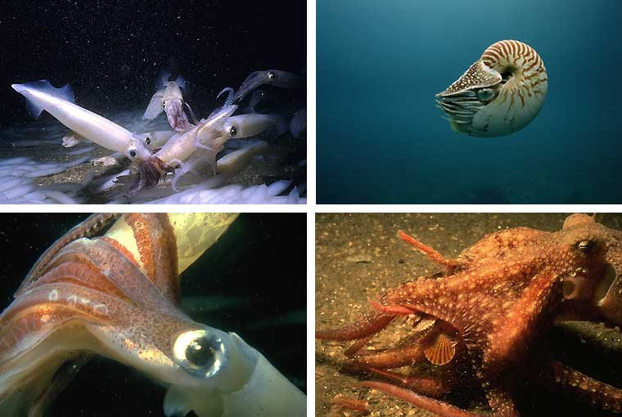
Phylum Mollusca: Class Cephalopoda

Slide 6
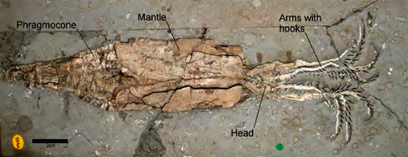
Exceptionally Preserved Squid (Jurassic Oxford Clay of Wiltshire)

Slide 7
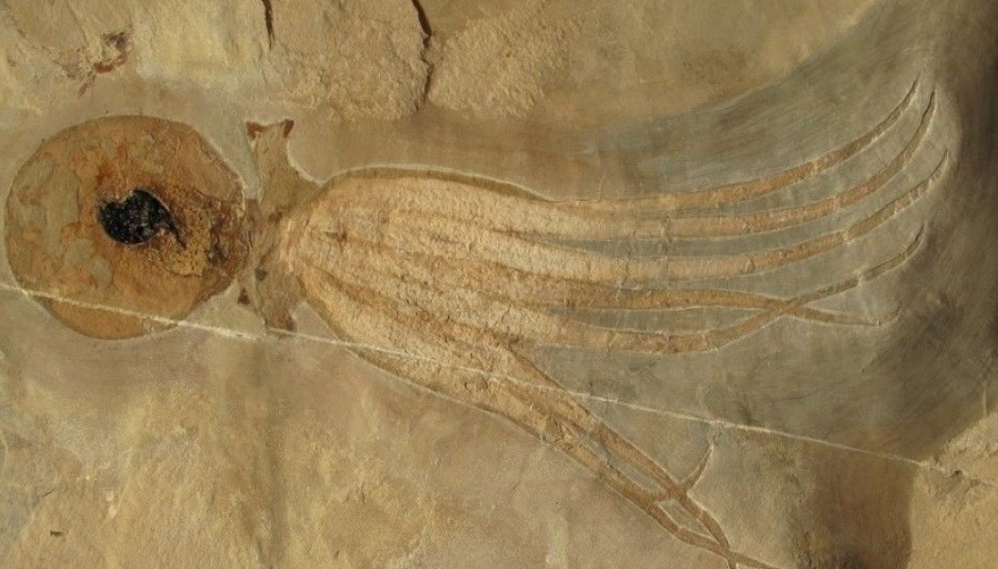
Exceptionally preserved Octopods

Slide 8
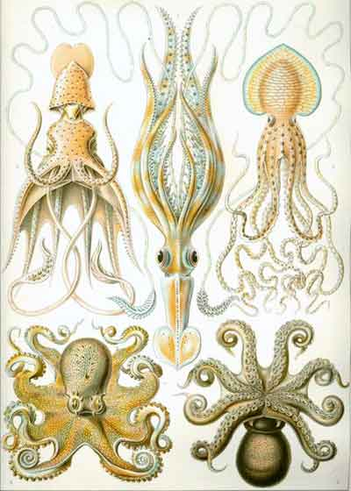
Modern Cephalopoda

Slide 9
Cephalopoda: how advanced?
Collaborative hunting techniques
Capable of complex and dexterous movement
Can communicate via colour change of skin
Complex optics suggests that their brain has some degree of processing power.

Slide 10
Cephalopoda: how advanced?
Tool use!
http://www.youtube.com/watch?v=AP_dpbTbess
Finn, JK, Tregenza, T, and Norman, MD, 2009. Defensive tool use in a coconut-carrying octopusCurrent Biology, Volume 19, Issue 23, 1069-1070
http://download.cell.com/current-biology/pdf/PIIS0960982209019149.pdf?intermediate=true

Slide 11
Cephalopoda: In the blood
Blood composed of hemocyanin, copper based organic molecule. This is dissolved in the blood and not carried in acell.
Deoxygenated form is clear, oxygenated form is blue.
Cephalopod blood greater oxygen carrying capacity than other molluscs.
Modern cephalopods capable of depleting oxygen reserve in venous blood. Does this imply a limit to the evolution of the cephalopod brain?

Slide 12
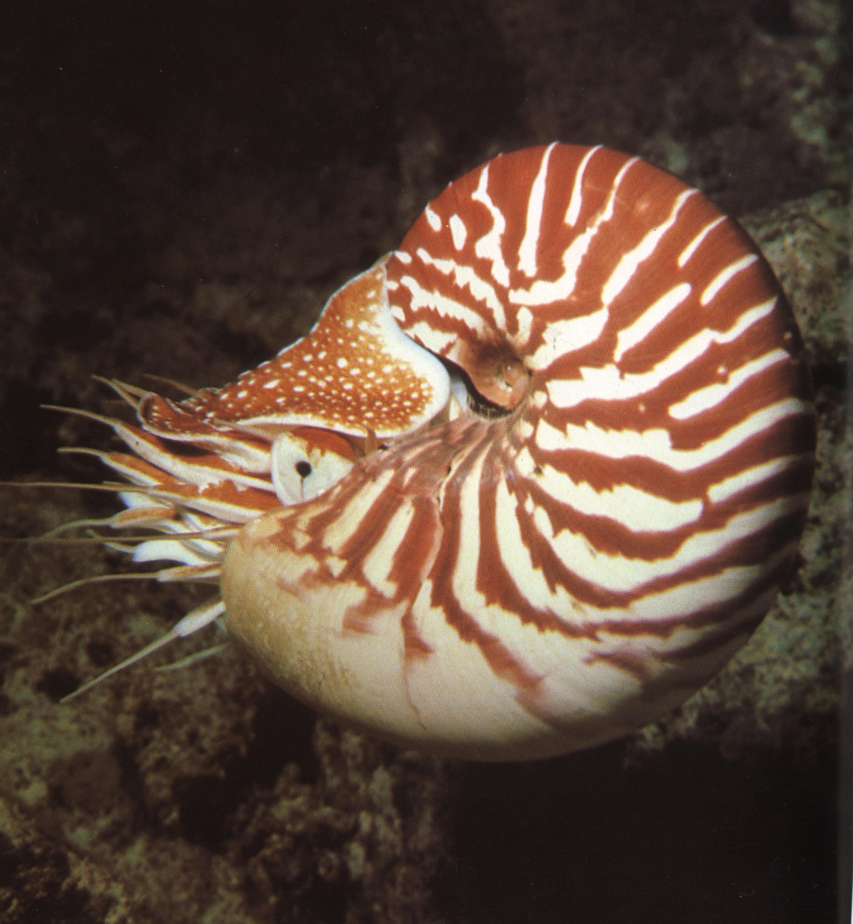
Modern Nautilus

Slide 13
Nautiloid: mode of life
Modern Nautilus is coiled and nektonic.
Shell is made of aragonite.
Can swim at up to 50cm/sec using a jet.
Can position the jet to swim backwards or forwards.

Slide 14
Segment 2
Fossil Cephalopods

Slide 15
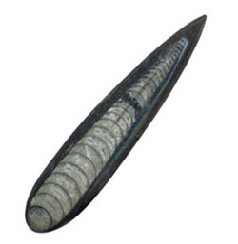
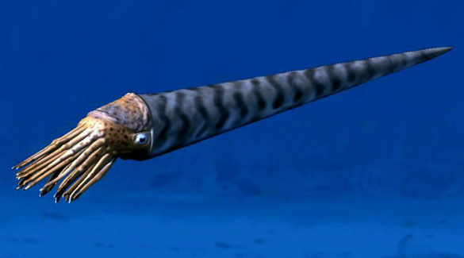
Fossil Orthocone Nautiloids adopted a range of shell shapes
Cameroceras is reported to have achieved lengths of 10m!!!!!!!
This makes it the biggest predator of its day (Ordovician to Silurian).
Note the genus name is something of a wastebasket term.

Slide 16
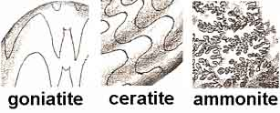
Subclass Ammonoidea: (400—65.0 MA)
Sutures
Orders
Goniatite Ceratite Ammonite

Slide 17
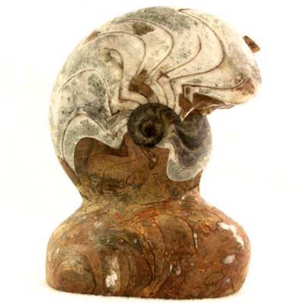
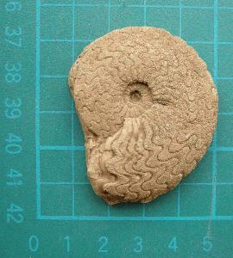
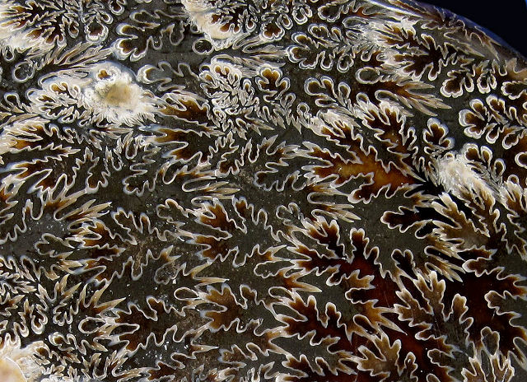
Subclass Ammonoidea: (479.0—65.0 Ma) Sutures
Sutures
Orders
Goniatite Ceratite Ammonite

Slide 18
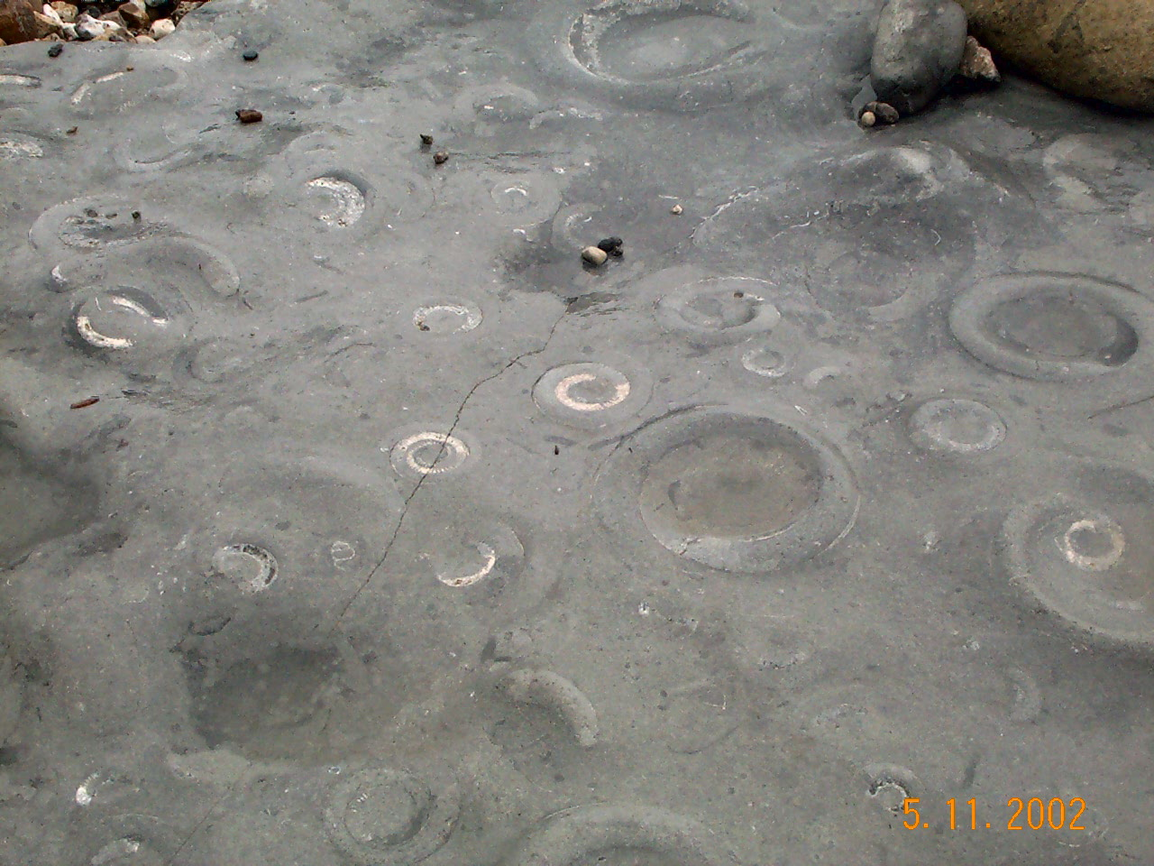
Ammonites

Slide 19
Fossil Cephalopod Shells
Ammonite shells were made of ARAGONITE
Ammonite shells were “largely” ectochliate (encapsulate the soft-tissue)
Belemnite shells were made of LOW MAGNESIAN CALCITE (LMC)
Belemnites were endochliate (inside the soft tissue)

Slide 20
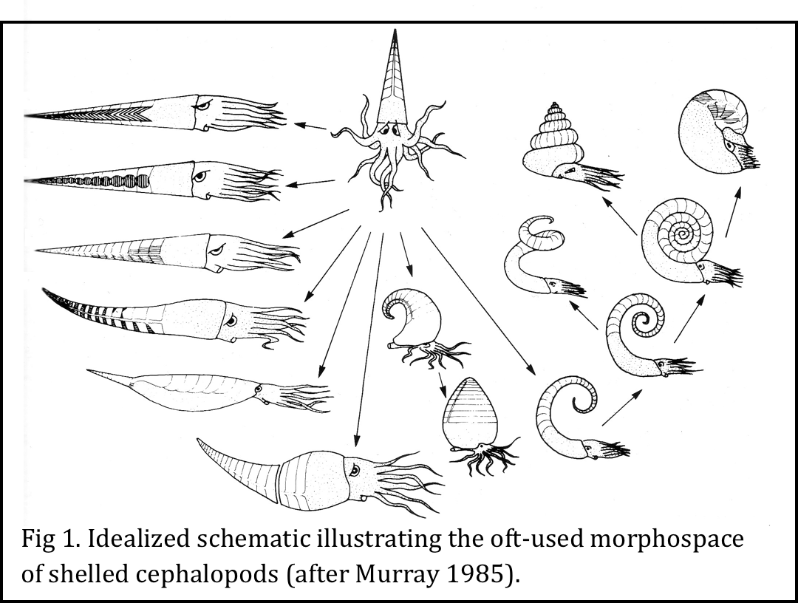
Shelled Cephalopod Morphospace

Slide 21
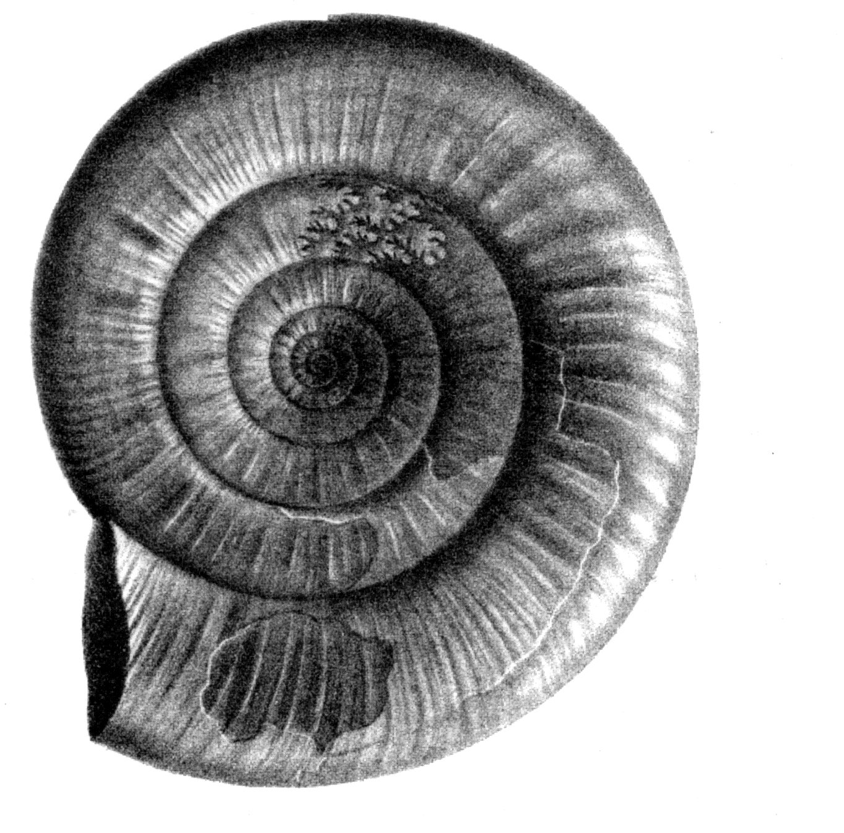
Order Ammonitida

Slide 22
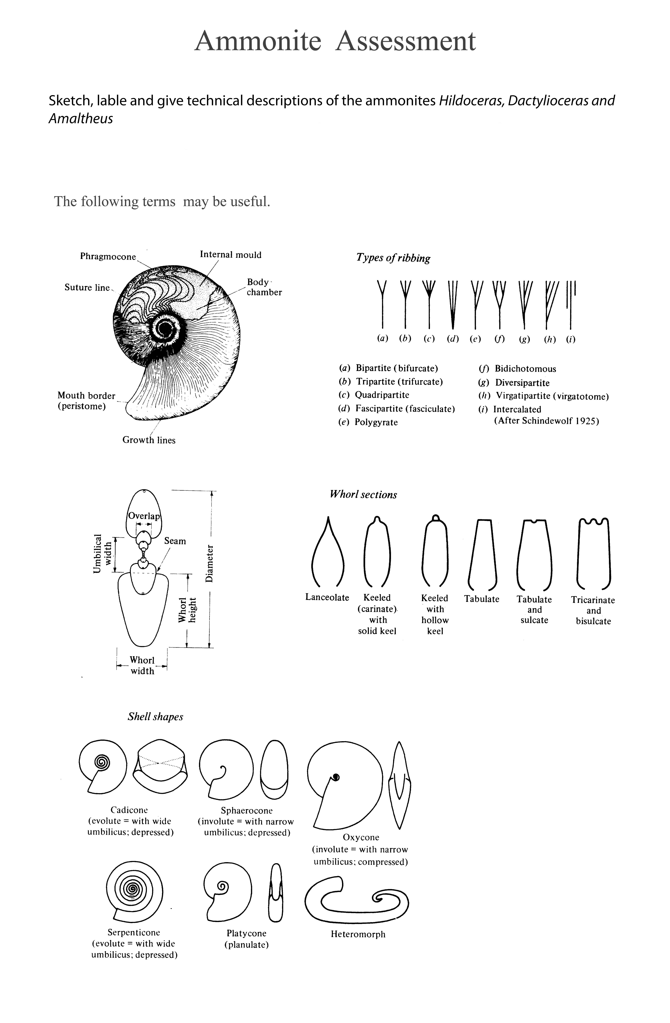
Order Ammonitida

Slide 23
Coiling evolute involute

Slide 24
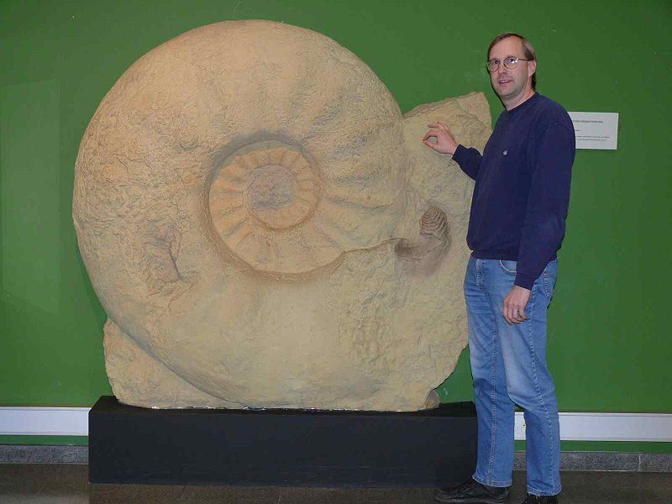
Parapuzosia seppenradensis The largest ammonite ever found over 1.8m in diameter

Slide 25
Cope’s Rule
Cope’s Rule is the tendency for organisms in evolving
lineages to increase in size over time.
What benefits might this confer?
What it a rule for all lineages or a “tendency” for some?
Look at the data in question 2 of the practical!

Slide 26

Ammonoid Shell Form

Slide 27
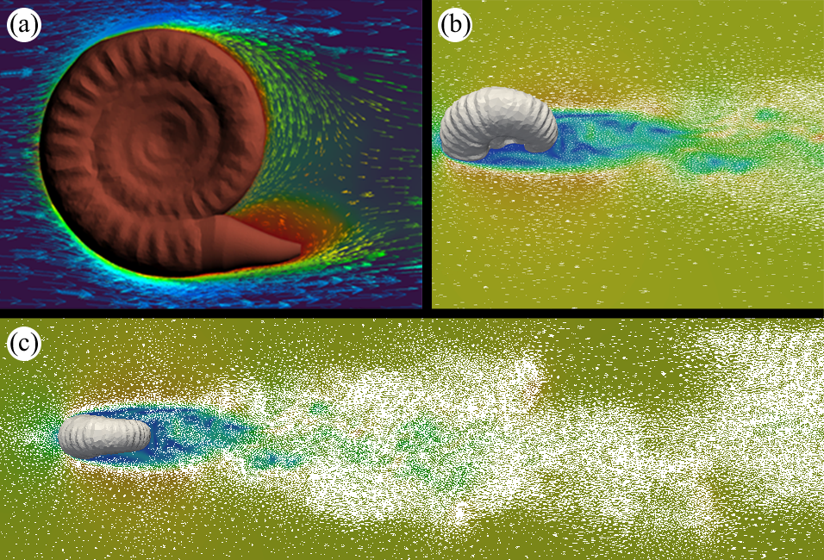
Ammonites Hydrodynamics
Fig. 2. Initial simulations of high Reynolds-number (1 x10⁴) flow past ammonite models; planes are isolated from 3D simulation, colours and arrows represent velocity. (a) Stephanoceras, lateral view, soft-parts modelled as conical prosthesis; (b,c) Calyoceras, oblique and top views respectively showing development of turbulent flow.

Slide 28
Hydrodynamics? evolute involute

Slide 29
Ammonites: mode of life
Modern Nautilus is nektonic.
What is the evidence for mode of life in ammonites?

Slide 30
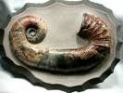
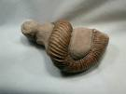
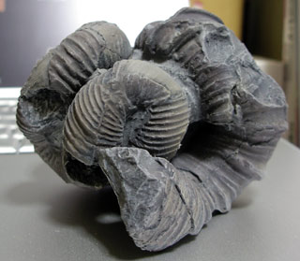
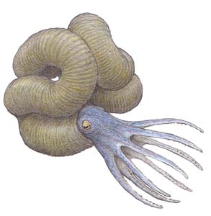
Ammonites Heteromorphs

Slide 31
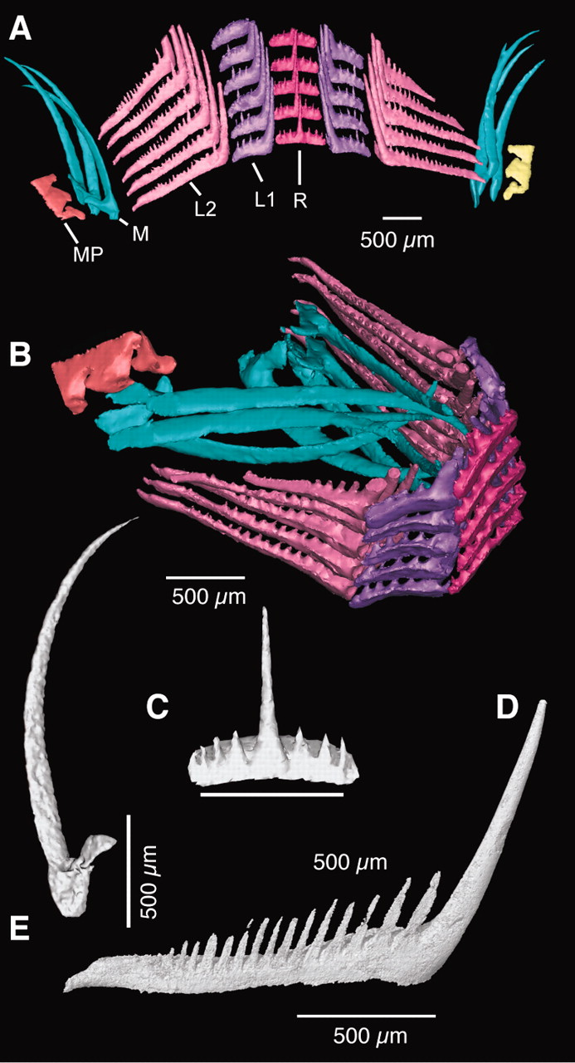
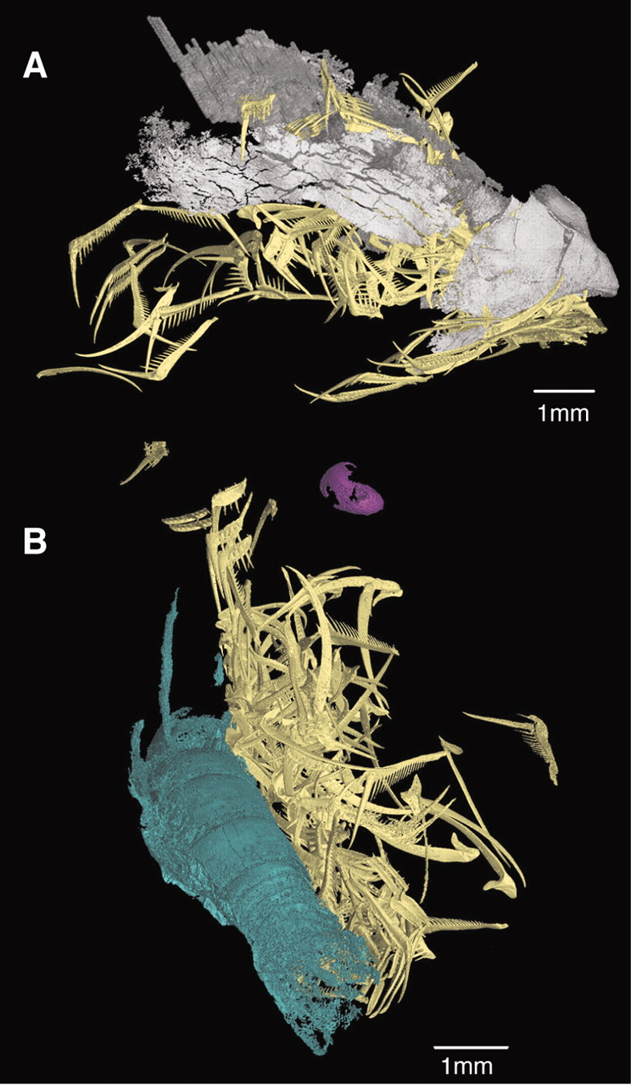

Fig. 2 Morphology of the radula and teeth in Baculites sp.
Kruta et al. Science 2011;331:70-72
Published by AAAS
Notes:
Morphology of the radula and teeth in Baculites sp. (A) Virtual reconstruction of the radula in Baculites sp. (AMNH 55901) as if unfolded. Rows of teeth are repeated all along the length of the radula. Blue, marginal teeth; light pink, second lateral teeth; purple, first lateral teeth; dark pink, rachidian teeth; yellow, marginal plates. (B) Part of the radula of Baculites sp. (AMNH 55901). The radula is folded, as it may have appeared in the tube-shaped radular canal. (C) Adoral view of the rachidian tooth. (D) Lateral view of the second lateral tooth, center of the ribbon on the right-hand side. (E) Lateral view of the marginal tooth.

Slide 32
Ammonites in the food chain

Slide 33
Ammonites-Zone fossils
Ammonites are zone-fossils par exellence
Ammonite zones in the Jurassic are = to 1 million years
Ammonite sub zones are equal to less than 80,000 years

Slide 34
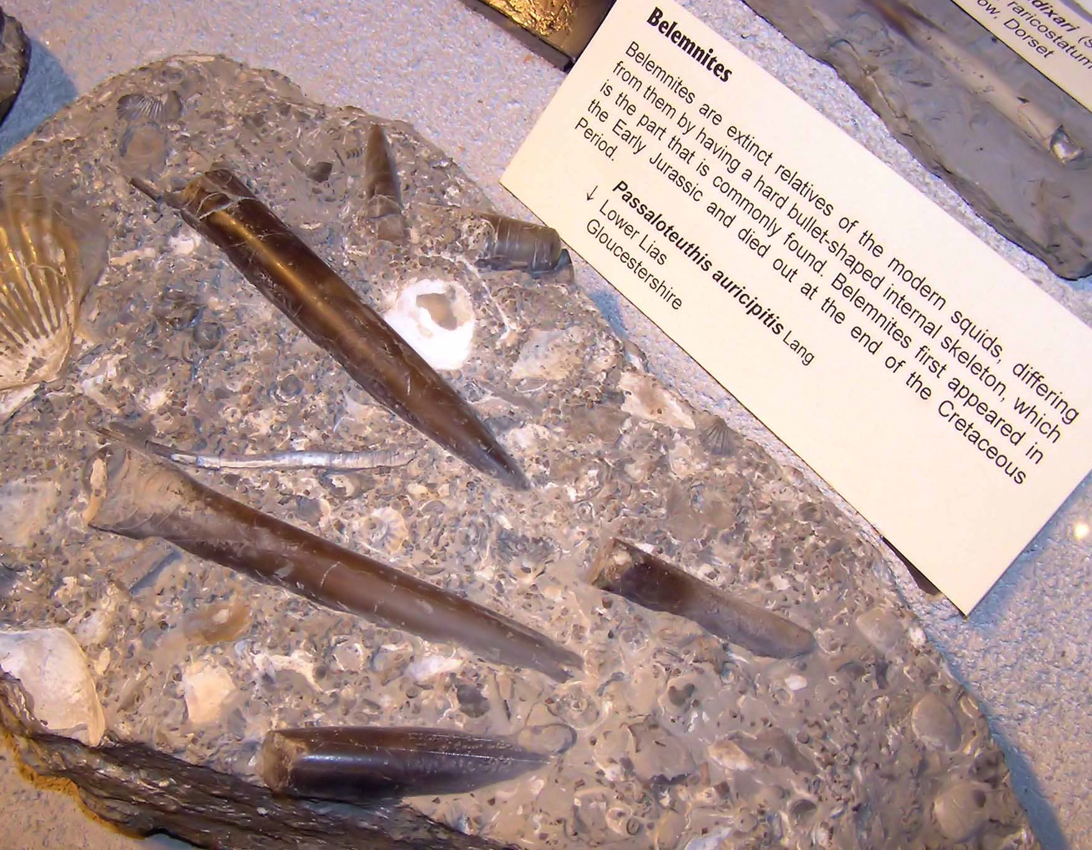
Belemnites

Slide 35
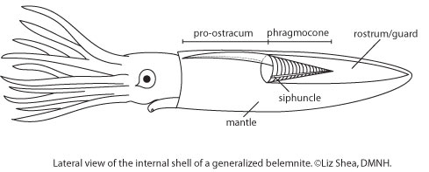
Belemnites

Slide 36
SEGMENT 3: Phylum Echinodermata
Class Echinoidea
Regularia
Irregularia
Class Crinoidea
Class Holothuroidea
Class Ophiuroidea
Class Asteroidea

Slide 37
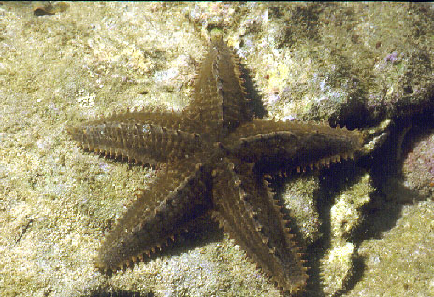
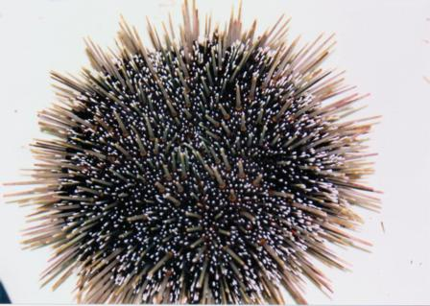
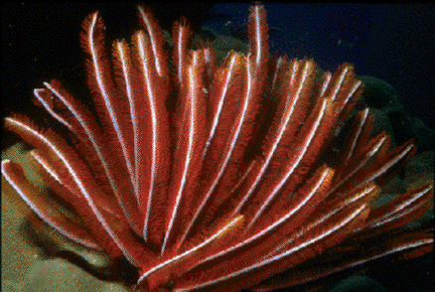
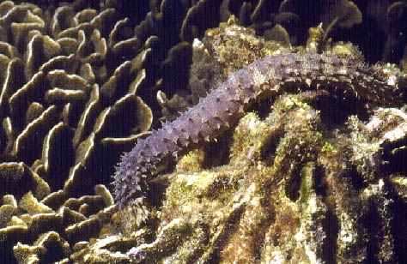
Phylum:Echinodermata (spiny skins)

Slide 38
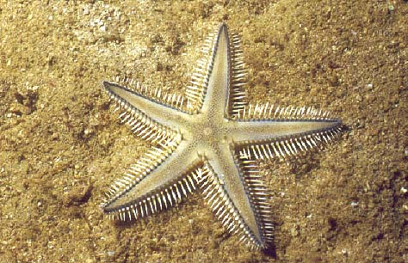
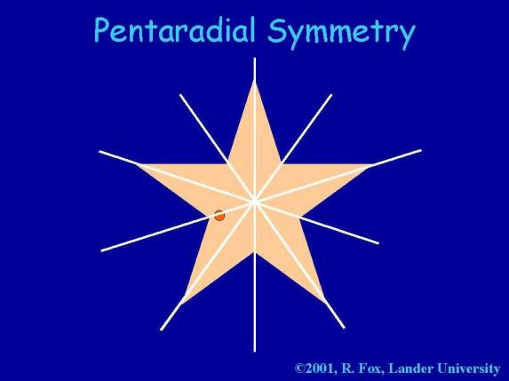
Echinoderm characteristics
Pentameral (5-fold) symmetry
Not perfect as some features, mouth, anus, and madreporite can be non central
Even where body is not pentaradial, elements of symmetry persist

Slide 39
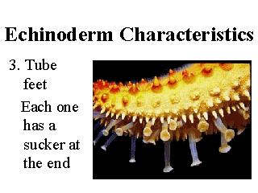
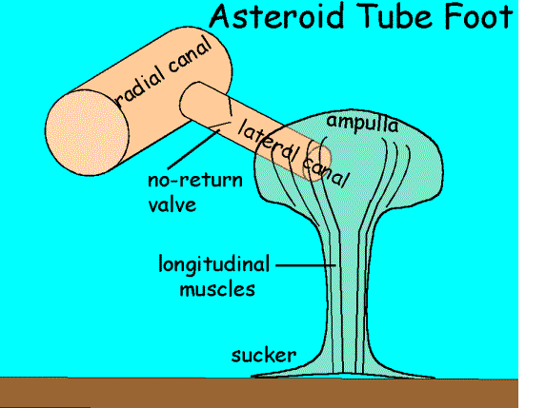
Water-vascular system
Tube feet used for movement and food acquisition and powered by hydraulic pressure

Slide 40
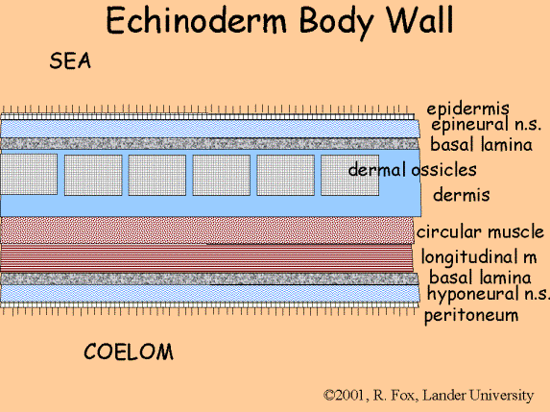
Echinoderm:construction

Slide 41
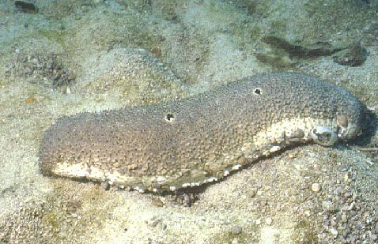
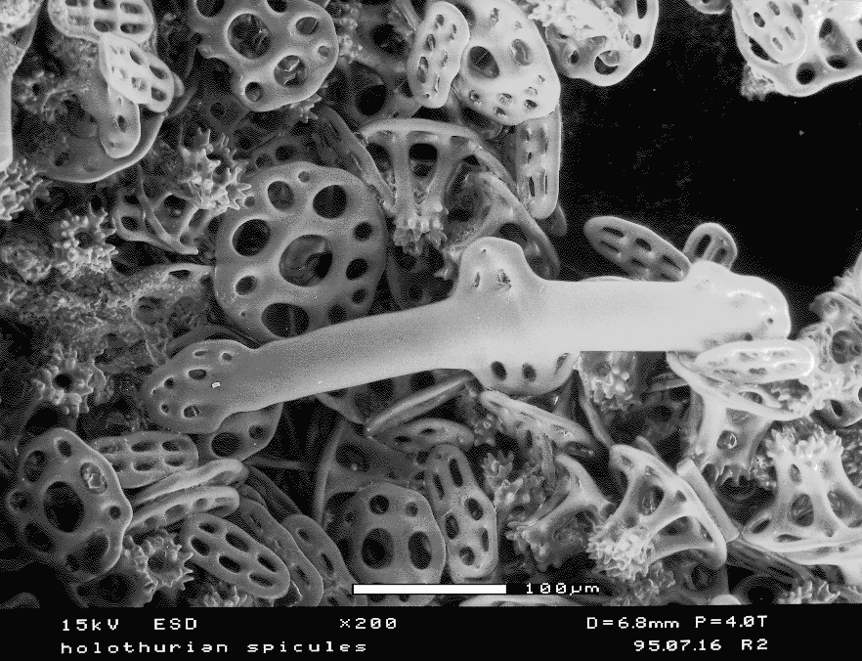
Holothurians (Sea-cucumbers)

Slide 42
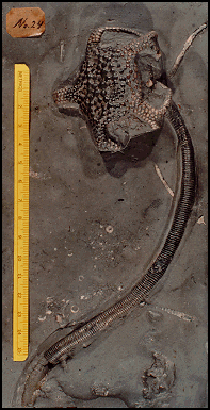
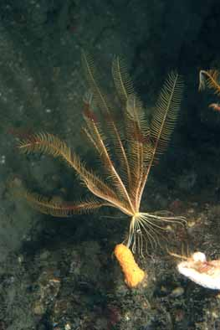
Crinoidea

Slide 43
Class:Echinoidea

Slide 44
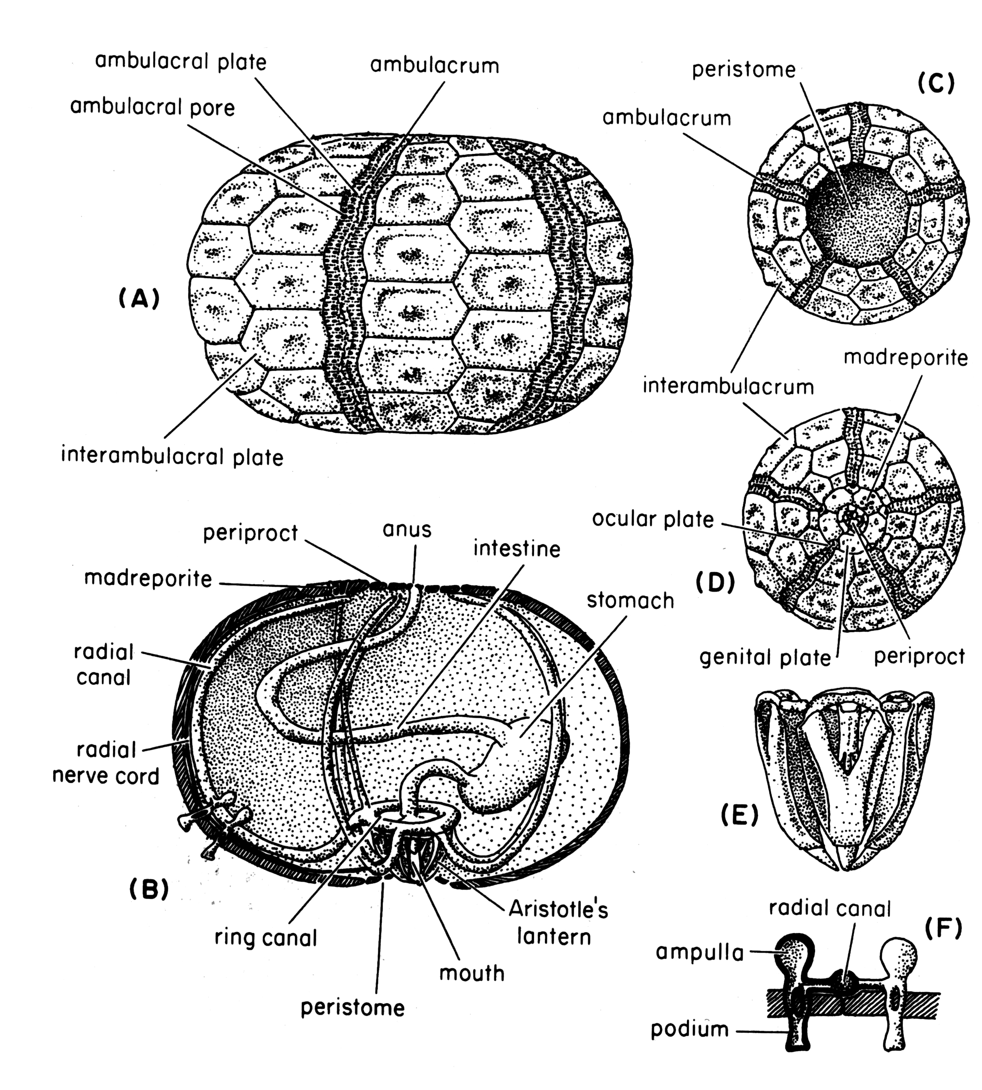
Echinoid test morphology

Slide 45
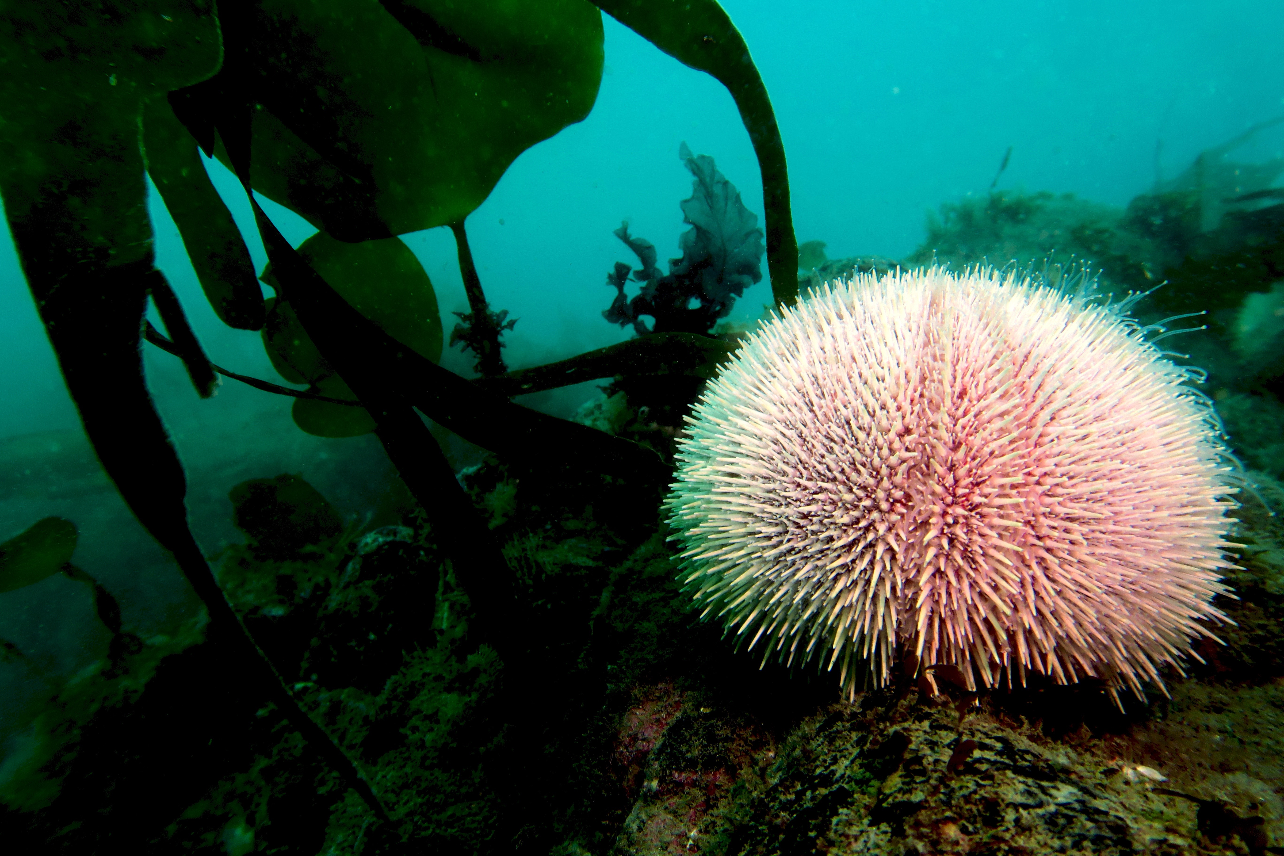
Echinoid test morphology

Slide 46
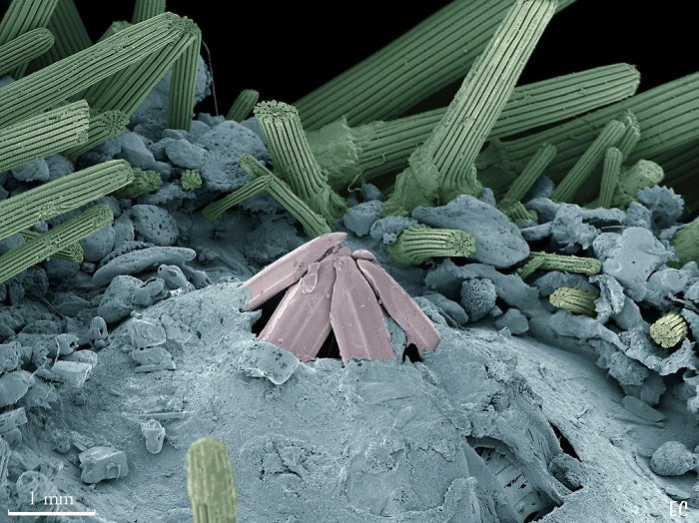
Oral surface

Slide 47
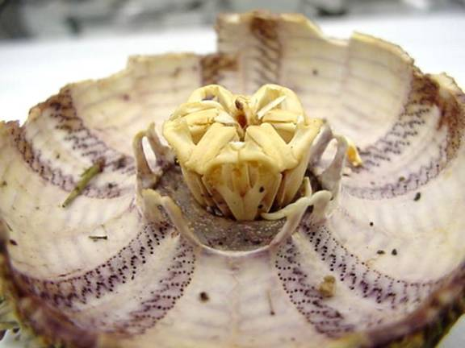
Teeth (Aristotle’s lantern)

Slide 48
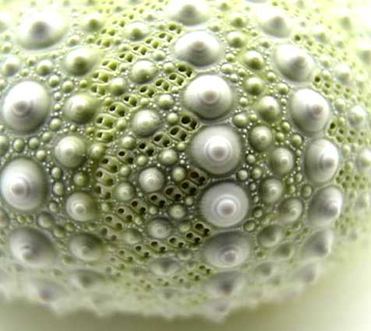
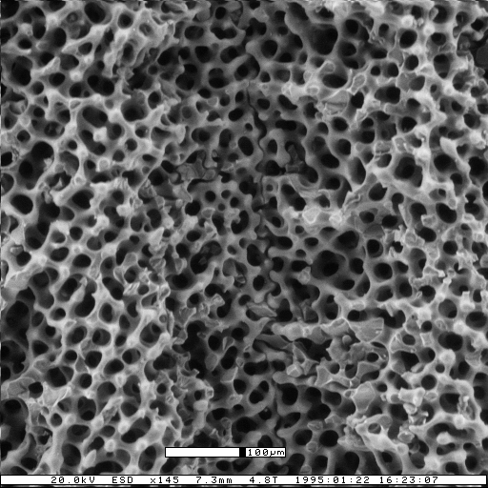
Test construction (stereom)

Slide 49
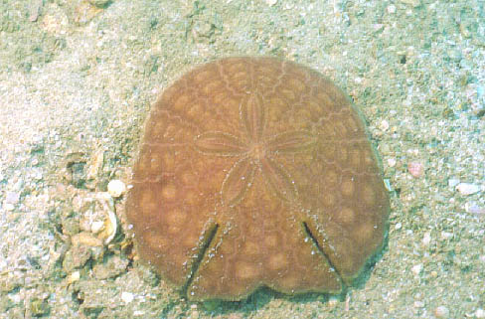
Echinoid Symmetry

Slide 50
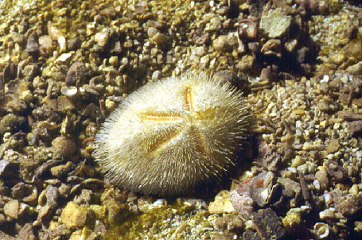
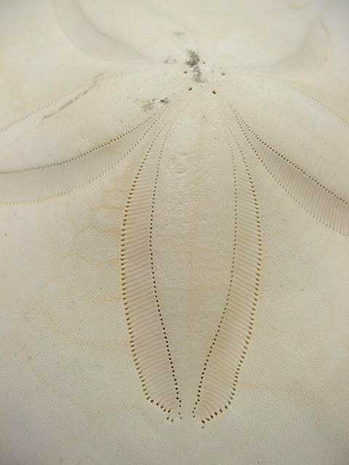
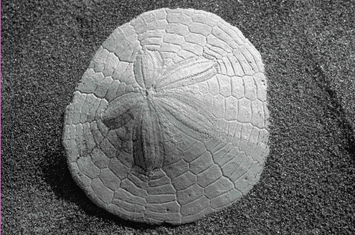
Irregularia

